Slide 1
Twitch Clip Recommender - COEN 241: Cloud Computing
Presentation by
JT Vinolus
Preeti Kakuru
Abhishek Rajanna
Brandon Quant
Yash Bhargava
Notes:
JT
Twitch clip recommender which is a platform that allows user to watch recommended twitch clips based off of their own preferences.

Slide 2
Motivation and Problem Statement
Twitch is one of the biggest leaders of live content streaming platforms. Rivaling YouTube live, Twitch as on February 2020 had about 3 million broadcasters and 15 million daily active users, generating terabytes of data annually.
As so many broadcasters must generate popular clips from a variety of games like Counter Strike: Global Offensive, Valorant and many more, browsing for the most popular clips becomes a hassle. Our Twitch Clip Recommender provides a solution to this problem.
Our project aims to get popular clips from a variety of broadcasters and present it to our user, without the user going through the hassle of finding the most popular clips on their own.
Notes:
Yash

Slide 3
Background Information - Amazon EC2
Amazon Elastic Compute Cloud
Amazon Elastic Compute Cloud (EC2) is a part of Amazon’s cloud computing platform AWS (Amazon Web Services).
Amazon EC2 promotes scalable deployment of applications by providing a web service through which a user is able to access and configure a virtual machine, in this case called an ‘instance’, which can be used to store and run any software / application so desired by the user.
One of the biggest advantages of Amazon EC2 is that the user pays by the second for active servers, which reduces the cost of operating the VMs on the platform.
Another advantage of using the Amazon EC2 is that it allows the user to have a choice of where they would like to have their instances situated geographically, which helps allows for latency optimization and helps with high levels of redundancy.
In our project, we aim to use Amazon EC2’s virtual instances to run the 2 main components of our project, which is the frontend, which includes our webpages and the backend, which includes our database and recommendation system.
Notes:
Yash

Slide 4
Background Information - Docker
Docker
Docker is an open source containerization platform. It is an application build and deployment tool, which is based on the idea of that you can package your code with dependencies into a deployable unit called a container.
Docker is an operating system for containers, similar to how a virtual machine virtualizes server hardware, containers virtualize the operating system of a server.
Docker Image
A Docker container image is a lightweight, standalone, executable package of software that includes everything needed to run an application: code, runtime, system tools, system libraries and settings.
Docker images contain executable application source code as well as all the tools, libraries, and dependencies that the application code needs to run as a container. When you run the Docker image, it becomes one instance (or multiple instances) of the container.
Notes:
Preeti

Slide 5
Background Information - Docker Container
Container
A container is a standard unit of software that packages up code and all its dependencies so the application runs quickly and reliably from one computing environment to another.
Developers can create containers without Docker, but the platform makes it easier, simpler, and safer to build, deploy and manage containers and also they share same operating system. Containers work best when a specific application to handle an individual task is needed.
Containers virtualize the OS, splitting it into virtualized compartments to run container applications.
Notes:
Preeti

Slide 6
Background Information: Flask
Flask
Micro web framework written in Python for developing web applications which have a built-in development server.
Allows for easy integration between different Python files
Allows for customizability and flexibility in libraries
Enables request dispatching using REST API
Request dispatching using REST.
Flask is based on WSGI(Web Server Gateway Interface) toolkit
Notes:
preeti

Slide 7
Background Information: Routing
Routing
Nginx
Nginx is open source software for web serving, reverse proxying, caching, load balancing, media streaming, and more.
Aws Route 53
Amazon Route 53 is a highly available and scalable cloud Domain Name System (DNS) web service.
It is designed to give developers an extremely reliable and cost effective way to route end users to Internet applications by translating names like www.example.com into the numeric IP addresses like 192.0.2.1
Let's Encrypt
Lets Encrypt is a free, automated, and open certificate authority that allows people and organizations around the world to obtain, renew, and manage SSL certificates.
Freenom
Freenom is a world leading free domain provider.
Notes:
JT
Now I'll give some background information on the routing happening in platform.
To build out the communication infrastructure used for routing traffic, we used ….

Slide 8
Background Information - SQLite
SQLite
SQLite is an open-source software and it is a cross-platform DBMS that can run on all platforms, including macOS, Windows, etc.
It allows you to work on multiple databases simultaneously on the same session, thus making it very flexible.
It requires no extra configuration and stores information in ordinary disk files.
SQLite is a popular choice as the database to back small to medium-sized websites.
Notes:
Abhishek

Slide 9
Related Work
Streamscharts.com/clips:
This site is similar to our project but it only displays popular clips based on most views but our project focuses to tailor the clips to the user using recommendation system considering his interests.
Notes:
Yash

Slide 10
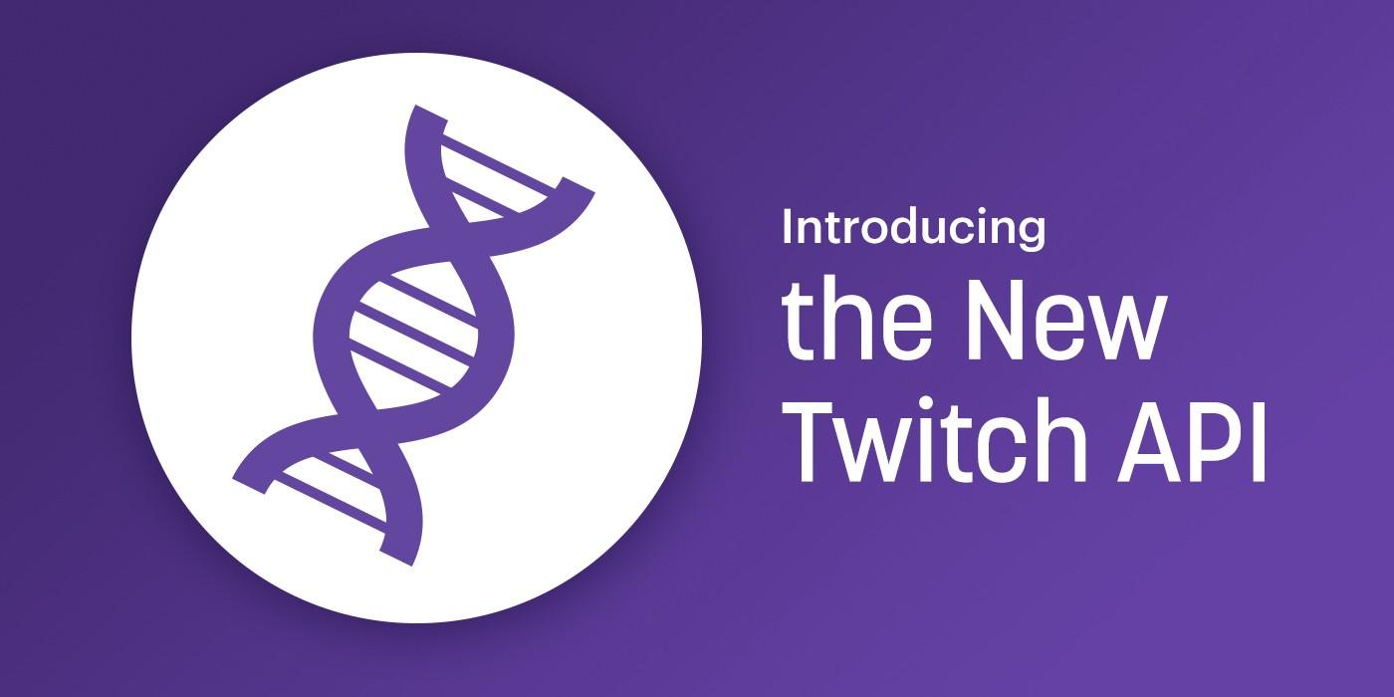


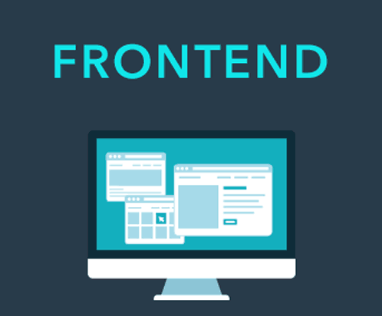


System
Architecture
Docker Container
User
Docker Container
Amazon EC2 Instance
Amazon EC2 Instance
Notes:
Abhishek

Slide 11
Technology Stack
Frontend
HTML
CSS
JavaScript
Backend
Python
Flask
SQLite Database
Cloud Technologies
Docker Containers/Files
Amazon EC2 Instances
Communication
REST API Calls
HTTP GET/POST
Routing
Nginx
Amazon Route 53
Freenom
Let’s Encrypted
Notes:
Abhishek

Slide 12

Software
Architecture
Queries API for clips
recommend(email)
Stores Clip URLs
Query from DB
Sends twitch clips
HTTP POST/GET Request
Query/Insert into DB
HTTP Response
Notes:
Brandon

Slide 13
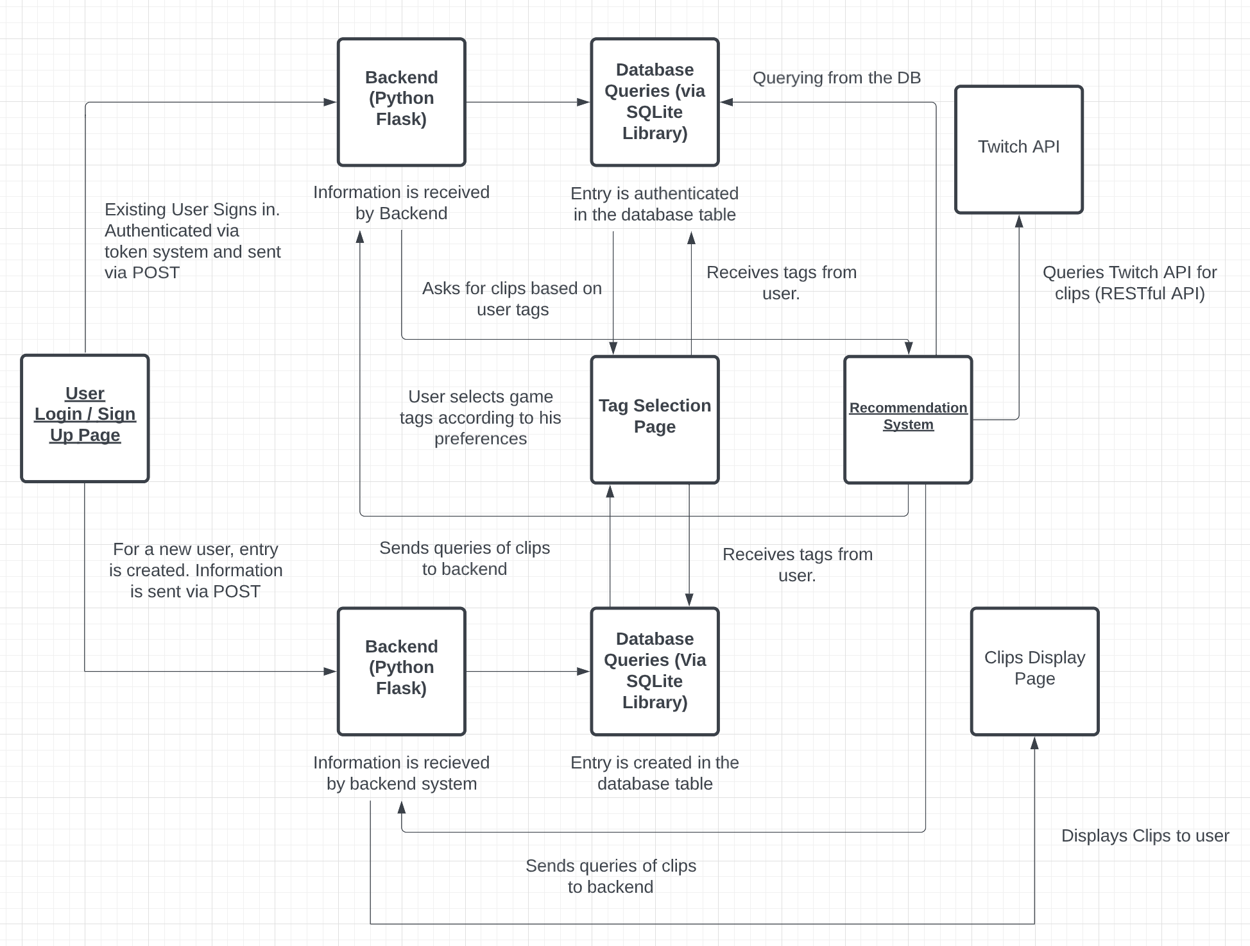
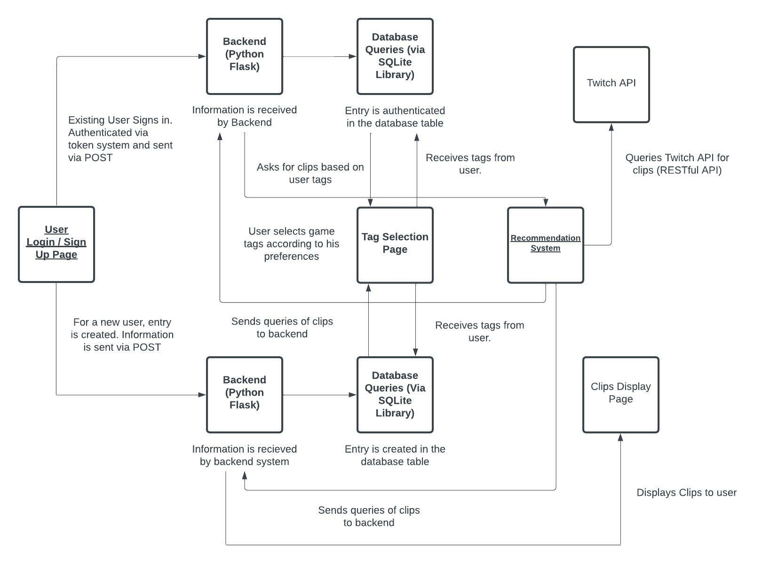
Software
Architecture
Flow
Notes:
Brandon

Slide 14
Routing In Depth
User accesses site using Frontend Domain
FE Server
BE Server
Container
Container
Nginx (Aws EC2)
Nginx (Aws EC2)
FE Hosted Zone
(Aws Route 53)
BE Hosted Zone
(Aws Route 53)
Docker routes port 5000 to 5000
Nginx routes 5000 to 443 and encrypt the traffic using “LetsEncrypt”
Route 53 DNS routes EC2 IP to Frontend domain
Encrypted traffic passed between both Hosted Zones
Route 53 DNS routes EC2 IP to Backend domain
Nginx routes 5000 to 443 and encrypt the traffic using “LetsEncrypt”
Docker routes port 5000 to 5000
Notes:
JT

Slide 15
Outcome
Twitch clip recommendation system based on user-selected tags
Ability for users to signup/sign in through the UI with authentication services
Dynamic system that will regularly pull new Twitch clips using the Twitch API
Exposure to web development using Flask and REST API to communicate between the frontend and backend
Understanding of containerizing the frontend and backend and running the containers on Amazon EC2 Instances
Practical experience with DNS and encrypting web traffic.
Notes:
Brandon

Slide 16
Demo
Notes:
JT: create new user → sign up → select tags → show twitch clips → logout → signin → keep categories → show twitch clips → logout → signin → change categories → show twitch clips → logout

Slide 17
Future Work
Incorporating machine learning models to create a more robust recommendation system.
Using more clip information to create a more detailed profile for recommendation.
Allow tags to be dynamically pulled from Twitch.
Adding a page where users can explore clips of different tags.
Converting SQLite database to Amazon S3 or DynamoDB.
Notes:
Abhishek

Slide 18
Questions?
Check Out
Clipz.ml
(for a limited time)
Notes:
JT

